Slide 1

GE Predix InSight Reporting Services Revenue Models & Strategies

Slide 2

API Monetization Models
Authors
Different Audiences…
Consumers
Application Developers
End Users
Report Creators
Have different values…

Slide 3
API Monetization Models
What they are trying to accomplish
Present information and content in easy-to-consume ways
Deliver rich & interactive experiences to their consumers
Quick time to market
Avoid headaches (no time to struggle with complexity)
Creating
Value they receive
Easy-to-use authoring tools
Aesthetically pleasing content presentation
Easy-to-consume APIs
Can quickly create products
Application Developers
Report Creators
What they are willing to pay for
Access to authoring tools
Mature operating platform (you run it!)
Training & Examples
Membership in a community of like-minded individuals
Early access to needed features
Authors

Slide 4
API Monetization Models
What they are trying to accomplish
Explore information to obtain insights
Discover trends & patterns
Optimize and manage situations
Prevent problems
Take advantage of opportunities
Consuming
Value they receive
Aesthetically pleasing content
Flexibility to work with any device at any time (mobile, desktop, web, etc.)
Reliability & Performance – it just works
Confidentiality & Security
End Users
What they are willing to pay for
Applications and tools that provide the above value
Resiliency & Availability of information (backup, storage)
Access to historical information (how long can you keep their information?)
Advanced features (social sharing, location-awareness, etc.)
Consumers

Slide 5
API Monetization Models
It’s imperative to recognize your intended user segments when preparing pricing models.
Authors
Consumers
Application Developers
End Users
Report Creators
Beware of “One-Size Fits All” models.

Slide 6
API Monetization Models
It’s equally important to consider business goals.
Drive innovation
BizDev / LeadGen
User acquisition Upsell opportunity
New line of business
Marketing channel
Increase footprint Distribution channel
Partner opportunities
API as Product
Device and mobile support
Content acquisition
Drive traffic
Increase stickiness Extend product
Accelerate internal projects

Slide 7
Free Model
Who should get access to “free”?
How long is it “free” for?
How do you convert “free” users to paid users?
Why free?
Developers?
Non-commercial users?
Everyone?
Increase stickiness & generate referrals
What’s included in “free”?
Basic capabilities?
1 Month?
Tiered subscription
Feature limits
Volume limits
Time limits
Drive traffic/acquire new users (low-friction adoption)
Improve product rapidly
3 Months?
1 Year?
Watermarking
Free to create
Free to view
Government
Academia
Non-profits
Open-source
Strengths
Everyone loves free
Manageable customer expectations
Low friction adoption
Challenges
Delayed revenue
Converting free users to paid users
Paying for costs

Slide 8
Pay-as-you-Go Model
Key Considerations
Strengths
Challenges
Can lead to complex pricing
Difficult for consumers to predict costs & budget
Commoditizes your offering
No lock-in to a subscription
Can charge customers a premium in exchange for low commitment
Low customer commitment required
Can lead to high level of customer churn
Why pay-as-you-go?
Pay for only what you use
What do you charge for?
Authoring reports
Discounts for features you use most
Report generation
# online reports generated
# of PDF pages generated
Access to advanced reporting features
Per month per user (report author)
Variations
Prepaid discounts
Flat fee per month for N units
Next N units additional cost above that
Next N units additional cost above that…
Tiered Pricing
Freemium (first tier is Free tier)

Slide 9
Subscription Model
Key Considerations
Strengths
Challenges
Flexible to accommodate different types of users
Predictable monthly costs for consumers
Predictable revenue for the business
Upsell opportunities
Higher commitment level required of consumer
Consumer is locked-in for period of time
Difficult to change pricing during subscription
Determining right price
Why pay-as-you-go?
Pay for only what you use
What do you charge for?
Authoring reports
Discounts for features you use most
Report generation
# online reports generated
# of PDF pages generated
Access to advanced reporting features
Per month per user (report author)
Viewing
# reports accessed
# pages viewed
# API calls
Variations
Basic
Basic Features
Volume Limits
# report definitions
# report views
Premium/Advanced
More features
Higher volumes
Enterprise
Advanced features
High included volumes
Enterprise support
Training/consulting?

Slide 10
Recommendations
Who should get access to “free”?
How long is it “free” for?
How do you convert “free” users to paid users?
Free tier available to all
What’s included in “free”?
Free tier is always free
Tiered subscription model
Feature limits
Volume limits
Report authoring
First N report definitions
N report generations/month
Limits on industrial-grade features (like coordinated phosphate graphs, etc.)
Free/Bronze/Silver/Gold
Advanced features could be available for tryout but with watermark embedded in reports to encourage conversion to paid tier
Report viewing

Slide 11



API Consumer Continuum
Your partners & customers
Everyone else
You
Internal
Private
Open

Slide 12
Ways to Think About KPIs for APIs
Developers
Traffic
Total calls Top methods Call chains Quota faults
Service Performance Availability Error rates Code defects
Total developers Active developers Top developers
Trending apps Retention
Marketing Dev registrations
Dev portal funnel Traffic sources
Event metrics
Business Direct revenue Indirect revenue
Market share
Costs
Support Support tickets Response times

Slide 13
More Ways…
Customer Satisfaction NPS
Churn
Community Forum activity Social media (both for API and apps built on it)
Quality Defects
Error prone APIs Repair rate
API Maturity Stability
Maturity metric Change rate
Innovation Number of products
Number of apps Speed to market
Channel
Call volume: Mobile,
web, others Revenue by channel

Slide 14
API Funnel
Acquisition Activation Retention Revenue Referral
How do developers ﬁnd you?
Does the developer have a good ﬁrst experience? Do developers return?
How do you and developers make money?
Do developers tell others?

Slide 15
Potential KPIs
Acquisition Activation Retention Revenue Referral
Dev portal site: sources, traﬃc vol, uniques
# dev registrations, API keys issued
# active devs, API call volume by dev, # apps
$ per dev, $ per app, # end users
# dev referrals, dev/app growth

Slide 16

App Users
Apps
Developers
Your APIs
You
API 1
API 2
API 3

Slide 17

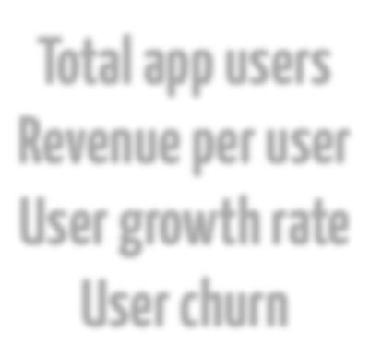
App Users
Apps
Developers
Your APIs
You
API 1
API 2
API 3
Total app users Revenue per user User growth rate User churn

Slide 18

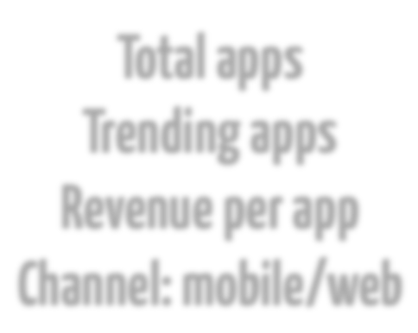
App Users
Apps
Developers
Your APIs
You
API 1
API 2
API 3
Total apps Trending apps Revenue per app
Channel: mobile/web

Slide 19

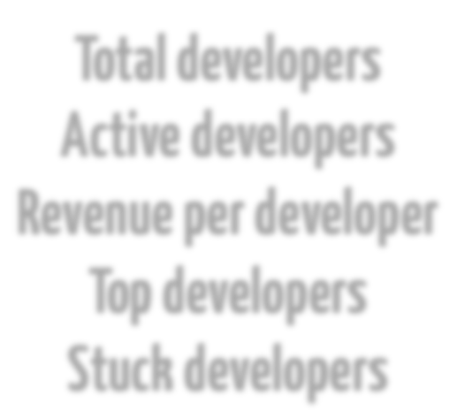
App Users
Apps
Developers
Your APIs
You
API 1
API 2
API 3
Total developers Active developers Revenue per developer Top developers
Stuck developers

Slide 20

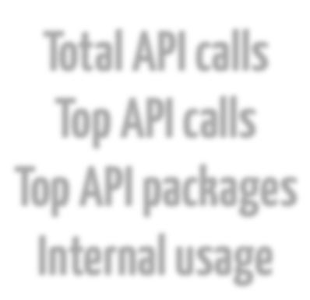
App Users
Apps
Developers
Your APIs
You
API 1
API 2
API 3
Total API calls Top API calls
Top API packages Internal usage

Slide 21


App Users
Apps
Developers
Your APIs
You
API 1
API 2
API 3
Total revenue Partnerships Market share Innovation

Slide 22







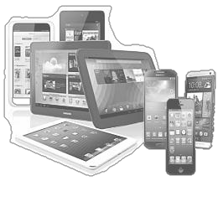
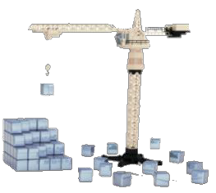
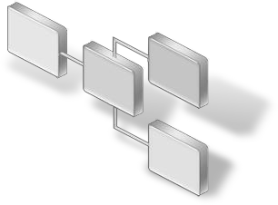


API Strategy
Grow revenue through
new channels
Deliver a differentiated
customer experience
Creation
Consumption
External APIs
Partner APIs
Assets &
Services
Application End
Points
Assembly
Transformation
Rationalization
Internal APIs
Discovery
Composition
Deployment

Slide 23












Developers Are at the Center
successful applications leverage
many APIs
Apps are as strong as their weakest API
APIs
Developers
Assets
Customers
drive
consumption of assets
control the
value chain
Apps
an API is successful only if the
application that uses it is successful
should be treated as products
APIs are used to drive adoption by
developers

Slide 24








Monetization Models – Some Examples
For Free
Developer Pays
Developer Gets Paid
Indirect
Drives Adoptions of APIs
Typically low valued
assets
Drive brand loyalty
Enter new channels
Business Asset must be of high value to the Developer
For example, marketing analytics, news,
Capabilities such as credit checks
Provides incentive for developer to leverage web API
Ad placements
Percentage of revenue sold product or services
Use of API achieves some goal that drives business model.
E.g. Increase awareness of specific content, or offerings
Example:
Example:
Example:
Example:
Facebook Login API provides free authentication for any Web / mobile app
Amazon EC2 Web Services – APIs charge per usage to launch and manage virtual servers.
Google AdSense APIs pay developers who include advertising content into apps
eBay Trading APIs offer developers access to trading services extending the reach of listings and transactions

Slide 25
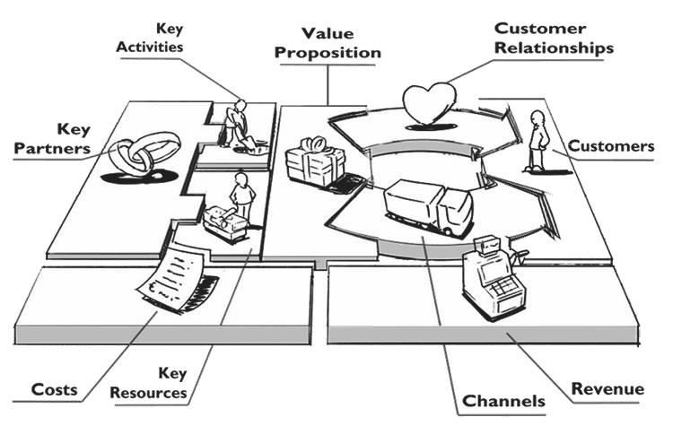
Business Model Canvas
A Business Model describes how you create,
deliver and capture value for your stakeholders
The business model canvas is a tool that helps
you describe and discuss your Business Model

Slide 26
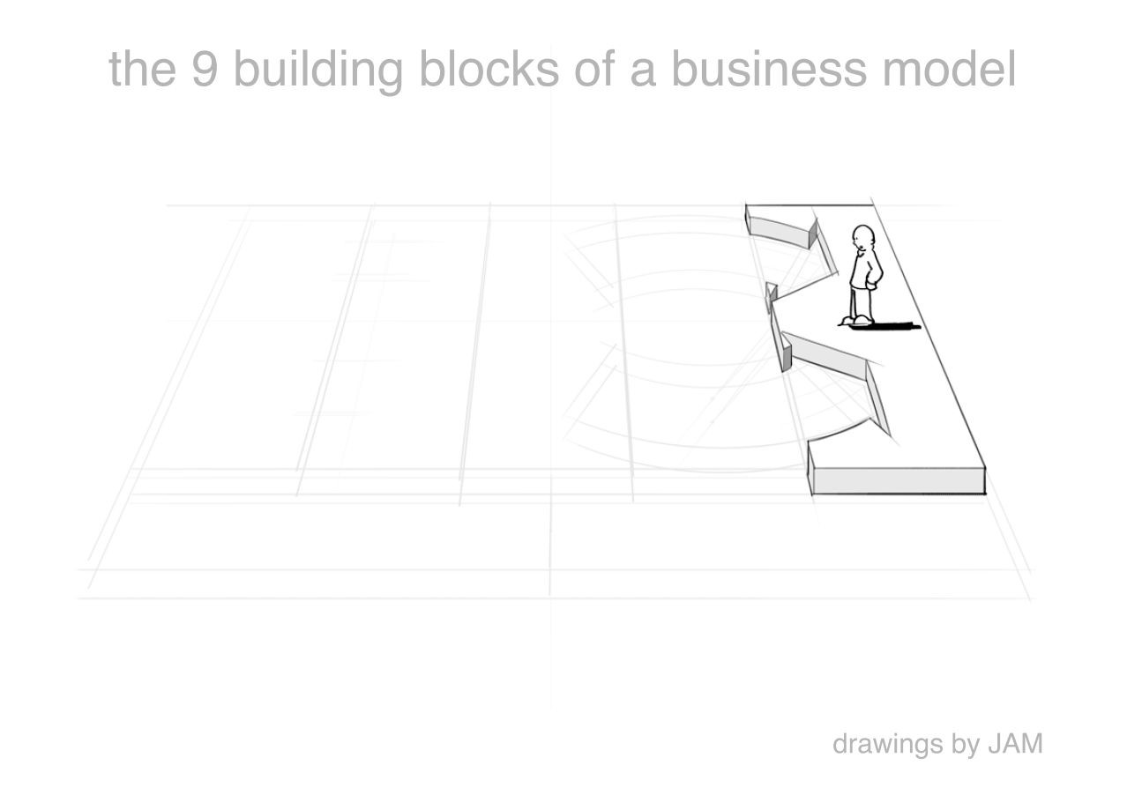
Customer Segments
which customers and users are you serving? which jobs do they really want to get done?

Slide 27
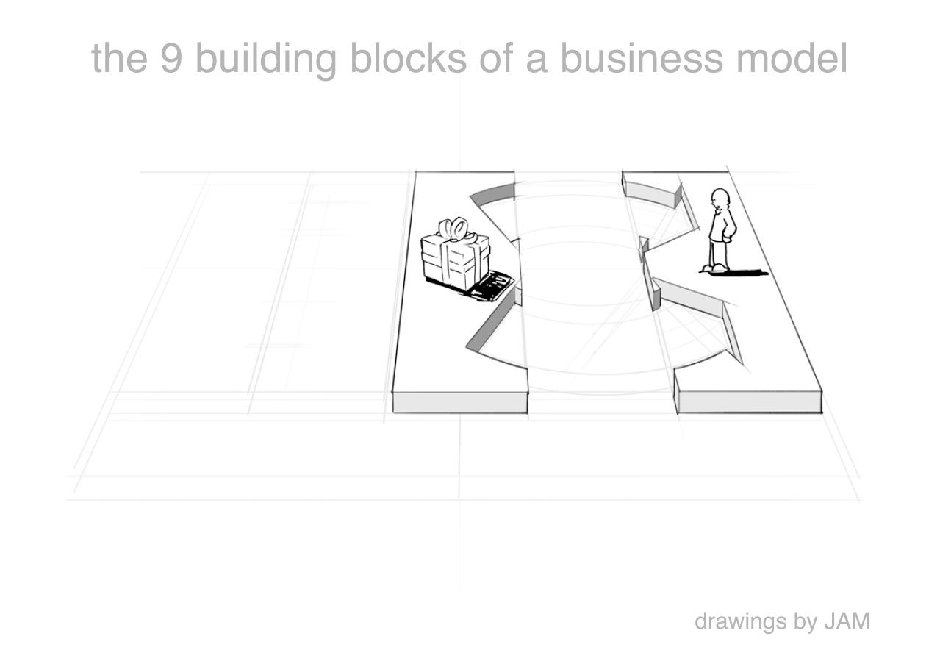
Value Proposition
what are you offering them? what is that getting done for them? do they care?

Slide 28
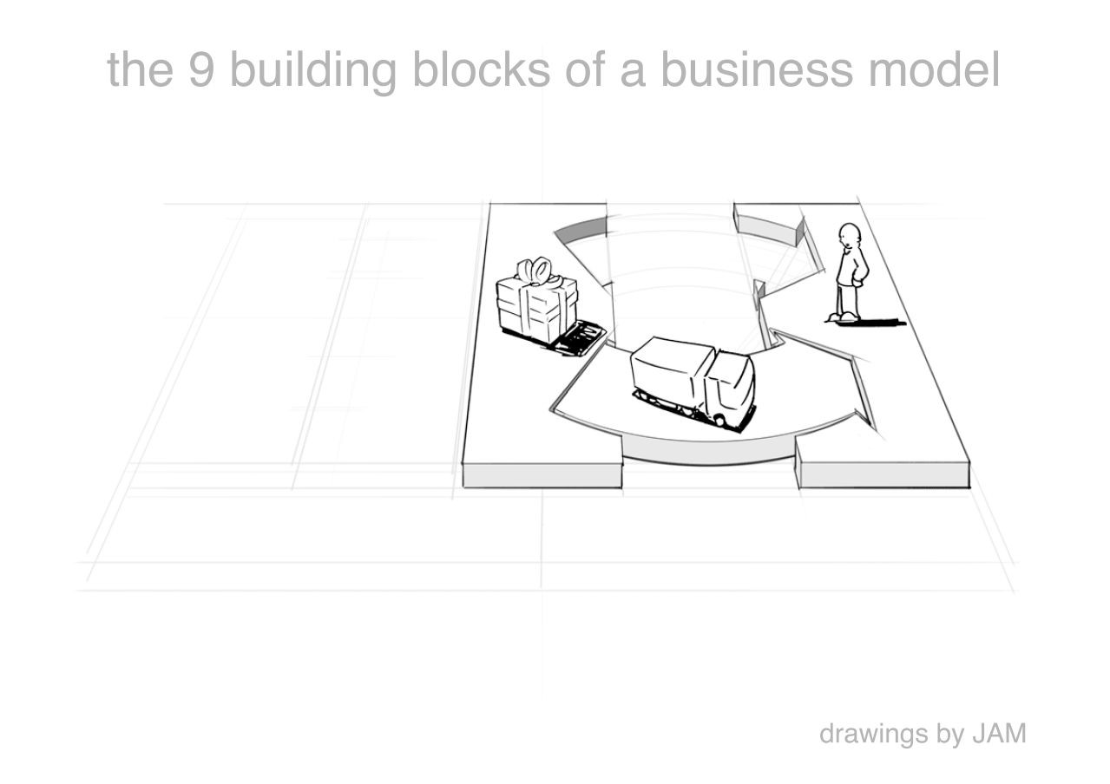
Channels
how does each customer segment want to be reached? through which interaction points?

Slide 29
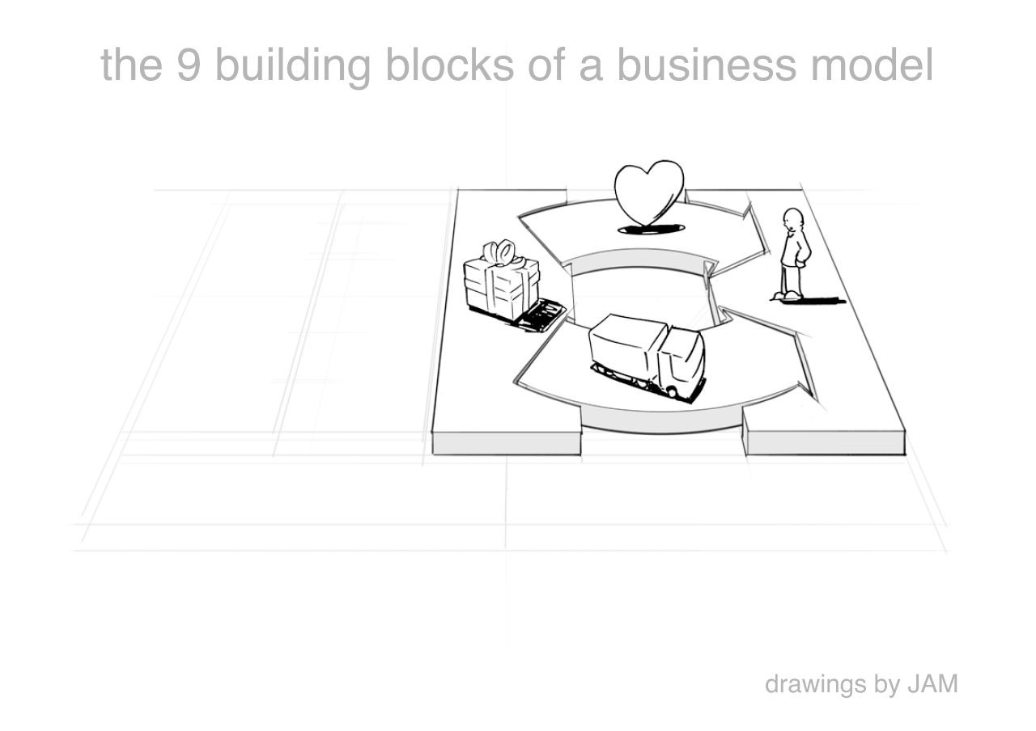
Customer Relationships
what relationships are you establishing with each segment? personal? automated? acquisitive? retentive?

Slide 30
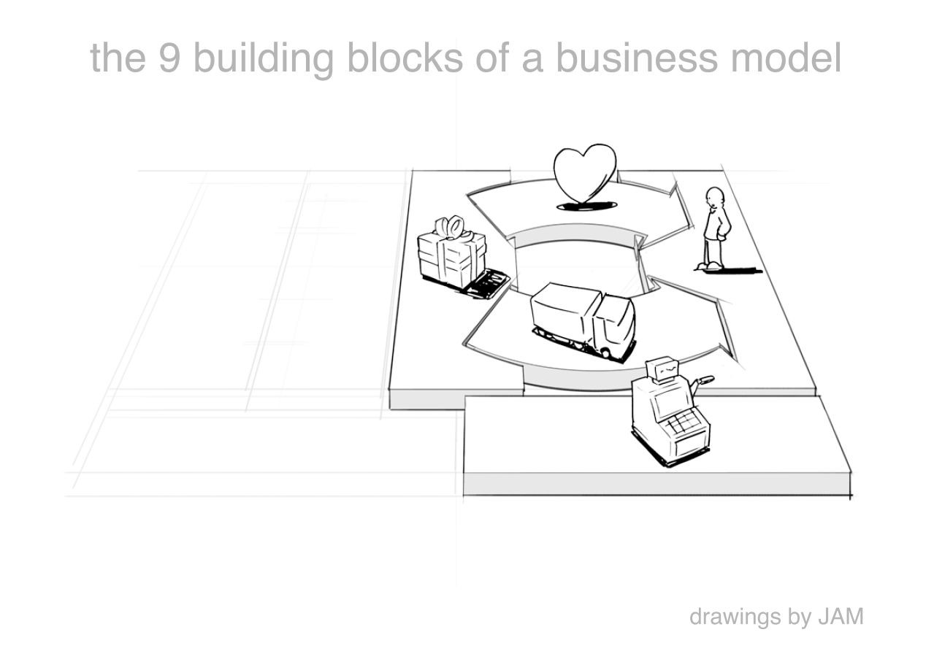
Revenue Streams
what are customers really willing to pay for? how?
are you generating transactional or recurring revenues?

Slide 31
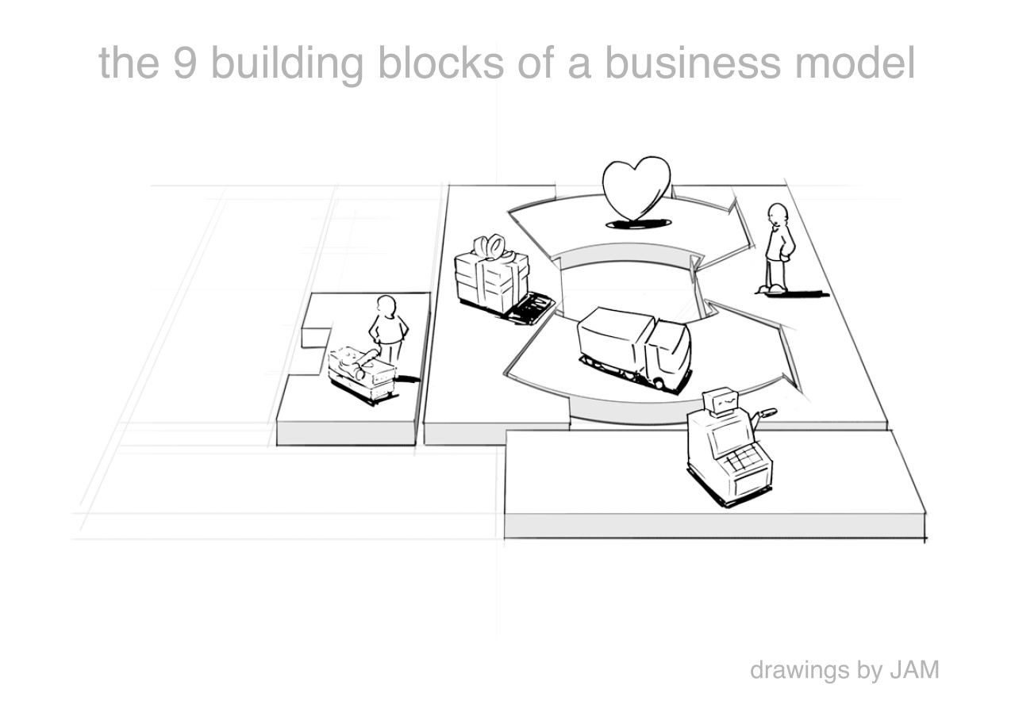
Key Resources
which resources underpin your business model? which assets are essential?

Slide 32
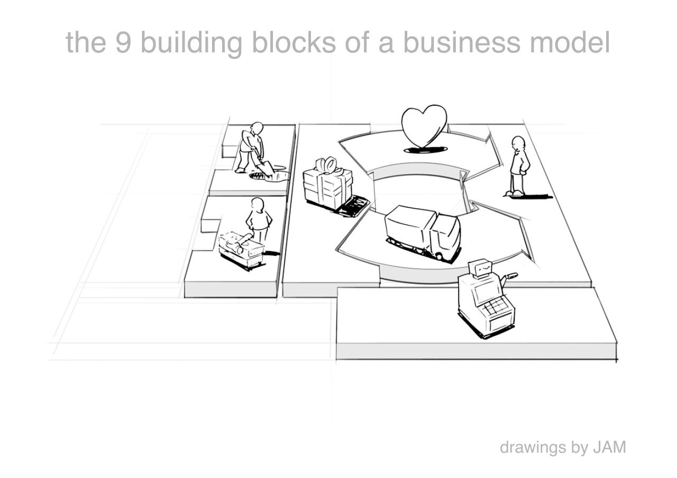
Key Activities
which activities do you need to perform well in your business model? what is crucial?

Slide 33
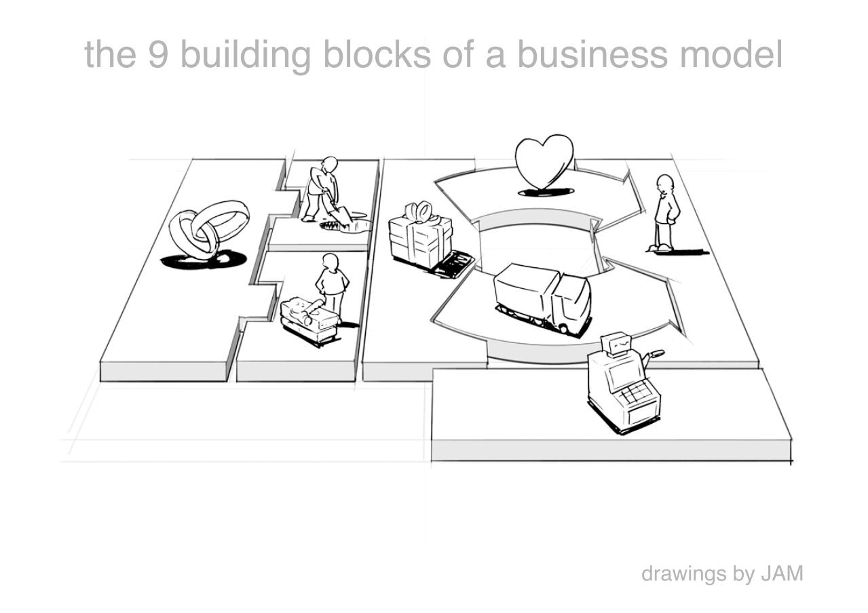
Key Partners
which partners and suppliers leverage your model? who do you need to rely on?

Slide 34
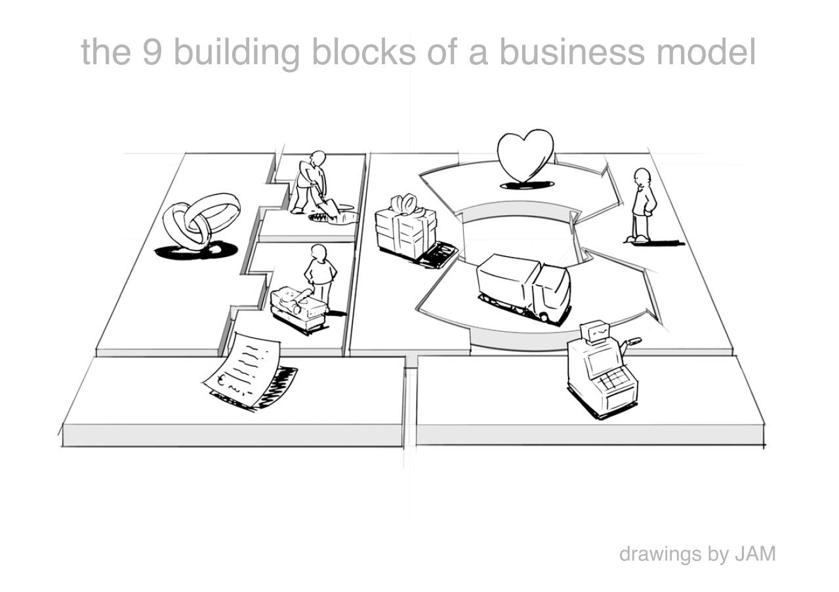
Cost Structure
what is the resulting cost structure? which key elements drive your costs?

Slide 35
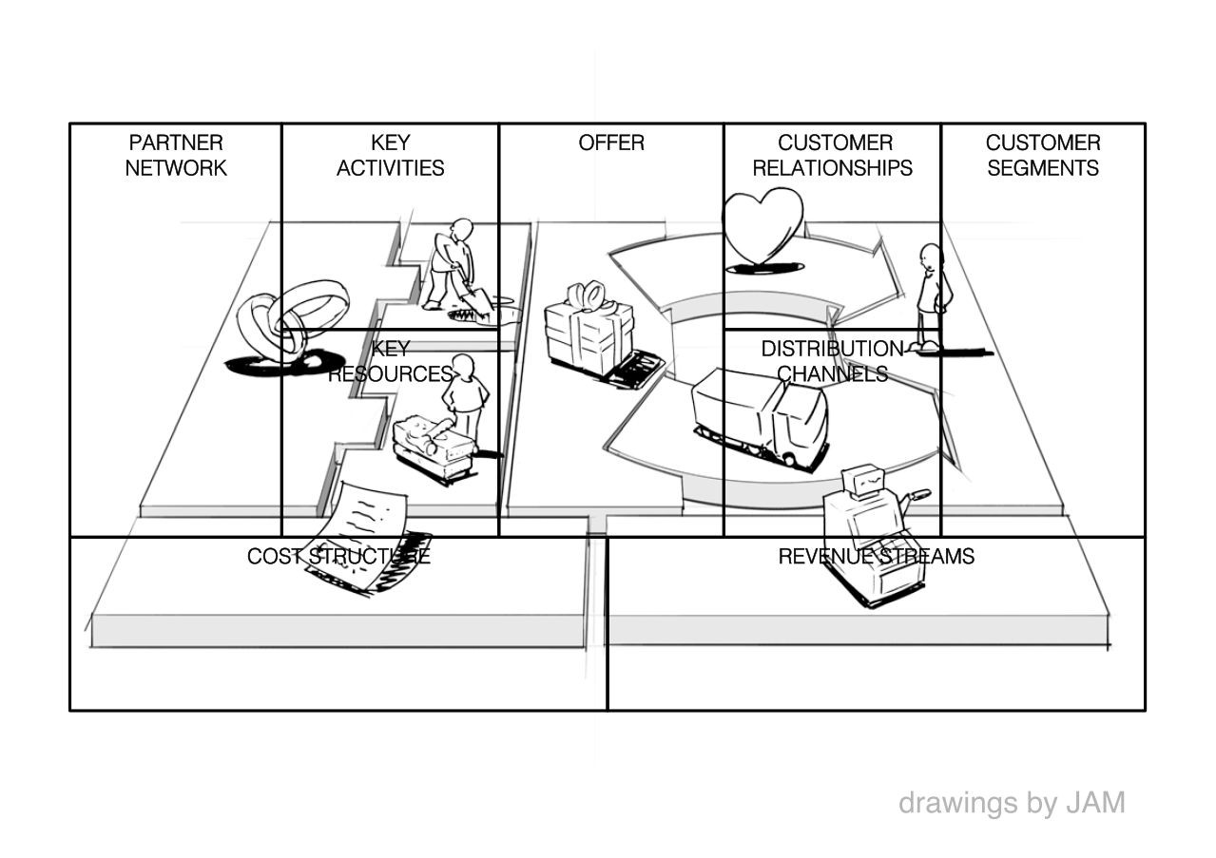
Business Model Canvas

Slide 36
Business Model Canvas
Key Partners
Key Activities
Value Propositions
Customer Relationships
Customer Segments
Device Makers
Development
Industrial Strength
Premium Enterprise Support
Large Industrials
Device Makers
Design (Product & Service)
Easy to Use
Self-Service Model (individuals, SMBs)
Fortune 1000
Marketing
Visually Stunning
Communities & Forums
Existing GE Customers/Prospects
Mobile
Key Resources
Channels
Brand
Customization
Sales Team
Industrial DNA
Targeted Media
Domain Knowledge
Professional Communities
Cost Structure
Revenue Streams
Marketing
Compute & Storage
Usage Fees
Membership/Subscriptions
Engineering
Ops

Slide 37


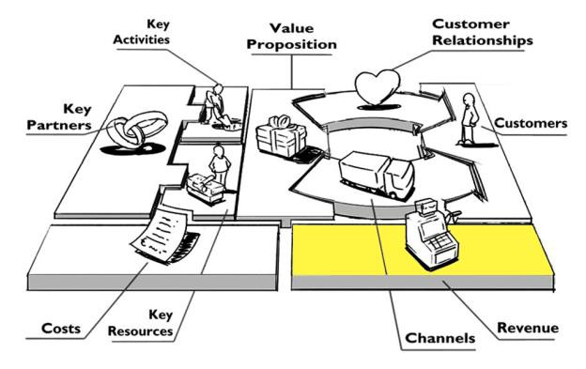








Revenue streams and APIs
What are customers really willing to pay for? How? Are
you generating transactional or recurring revenues
APIs
API revenue streams, e.g.:
Freemium
Tiered pricing
Pay per use
Unit based pricing
Transaction fee
Revenue share
Affiliate
As an upsell
Free
Developer
pays
Developer
gets paid
Indirect

Slide 38

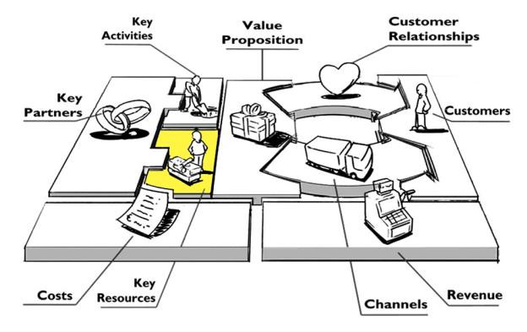









Key resources and APIs
Which key resources underpin your business
model? Which assets are essential?
API capabilities are a strategic resource
API management platforms offer additional capabilities, e.g.
Security mediation
Traffic Management
Partner Customization
Mobile Optimization
Versioning
Analytics
Monetization
Onboarding
API Documentation
Developer Authentication
Transformation
Maturity of API capabilities

Slide 39


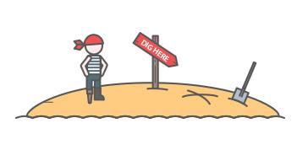

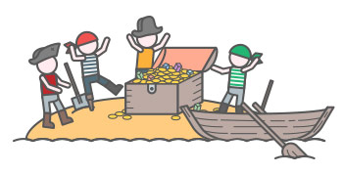
A
A
R
R
R
Pirate Metrics - AARRR
Acquisition
Activation
Retention
Referral
Revenue

Slide 40
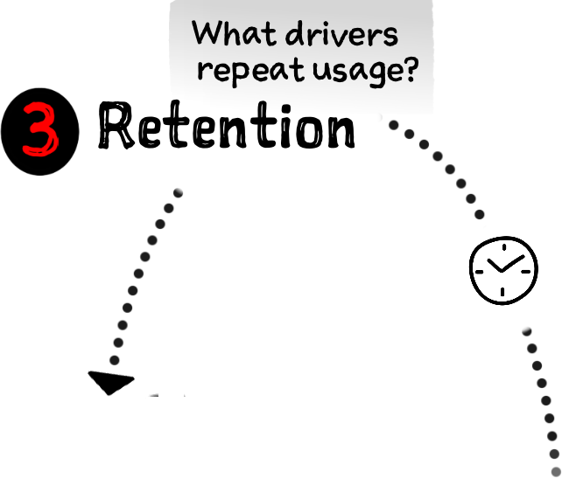

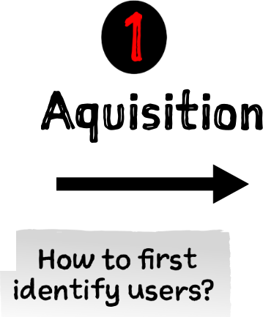

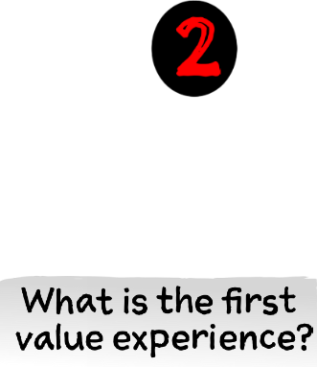

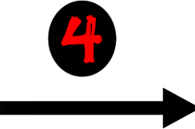



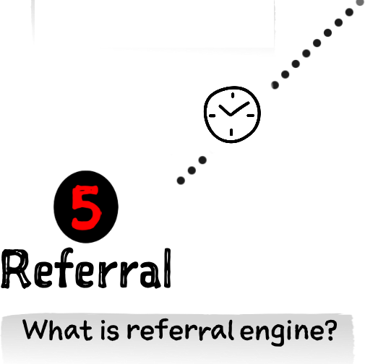

Pirate Metrics as Customer Factory Blueprint

Slide 41

Pirate Metrics as Sales Funnel
Unaware
ACQUISITION
ACTIVATION
RETENTION
REVENUE
Passionate Happy Customer
REFERRAL

Slide 42
Product/Market Fit
Product/market fit
Being in a good market
with a product that can satisfy that market.
~ Marc Andreessen
Product/Market Fit
traction
time

Slide 43
Product/Market Fit
Product/Market Fit
traction
time
Discovery
Validation
Efficiency
Scale
Empathy
Stickness
Scale
Virality
Revenue

Slide 44
Business Model Canvas Blank
Key Partners
Key Activities
Value Propositions
Customer Relationships
Customer Segments
Key Resources
Channels
Cost Structure
Revenue Streams

Slide 45


